Slide 1

2026-2027 Budget
April 21, 2026
Benjamin Barkley, interim superintendent
Natascha jock, school business executive
Shamrock PRIDE: People Respecting Individuality, Diversity & Educational Achievement

Slide 2
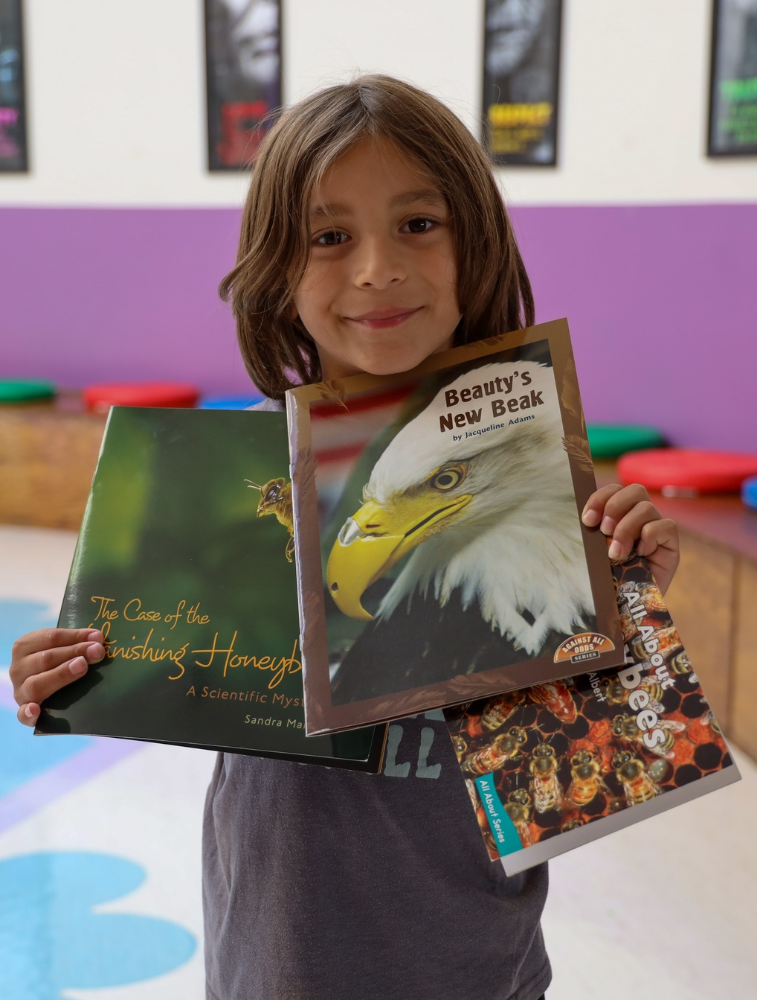
2026-2027 Budget Glance
$42,616,026 Budget
Budget GAP - $2.1M
2.83% Budget Increase
2% Tax Levy Increase

Slide 3
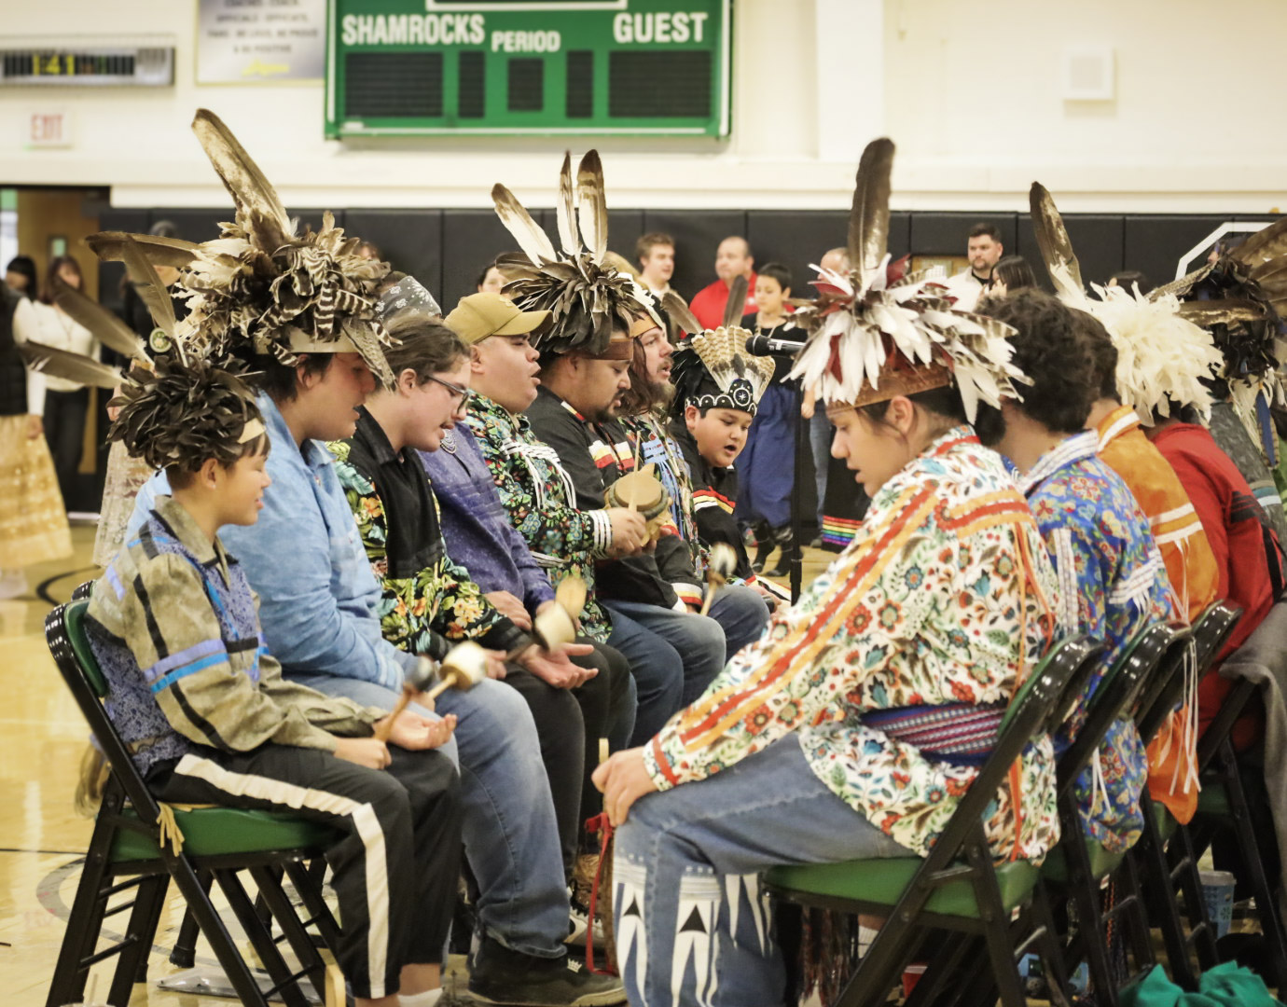
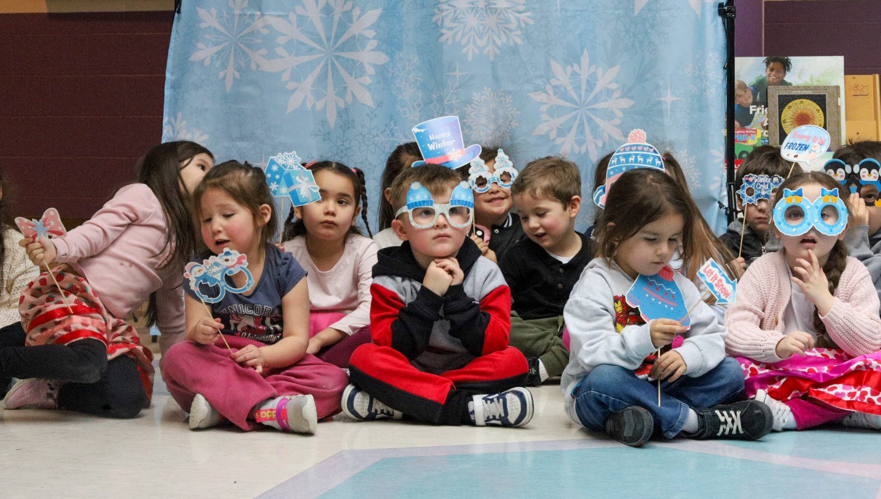
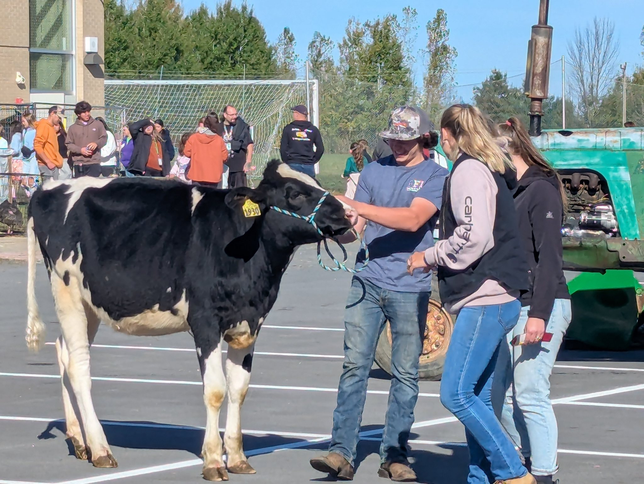
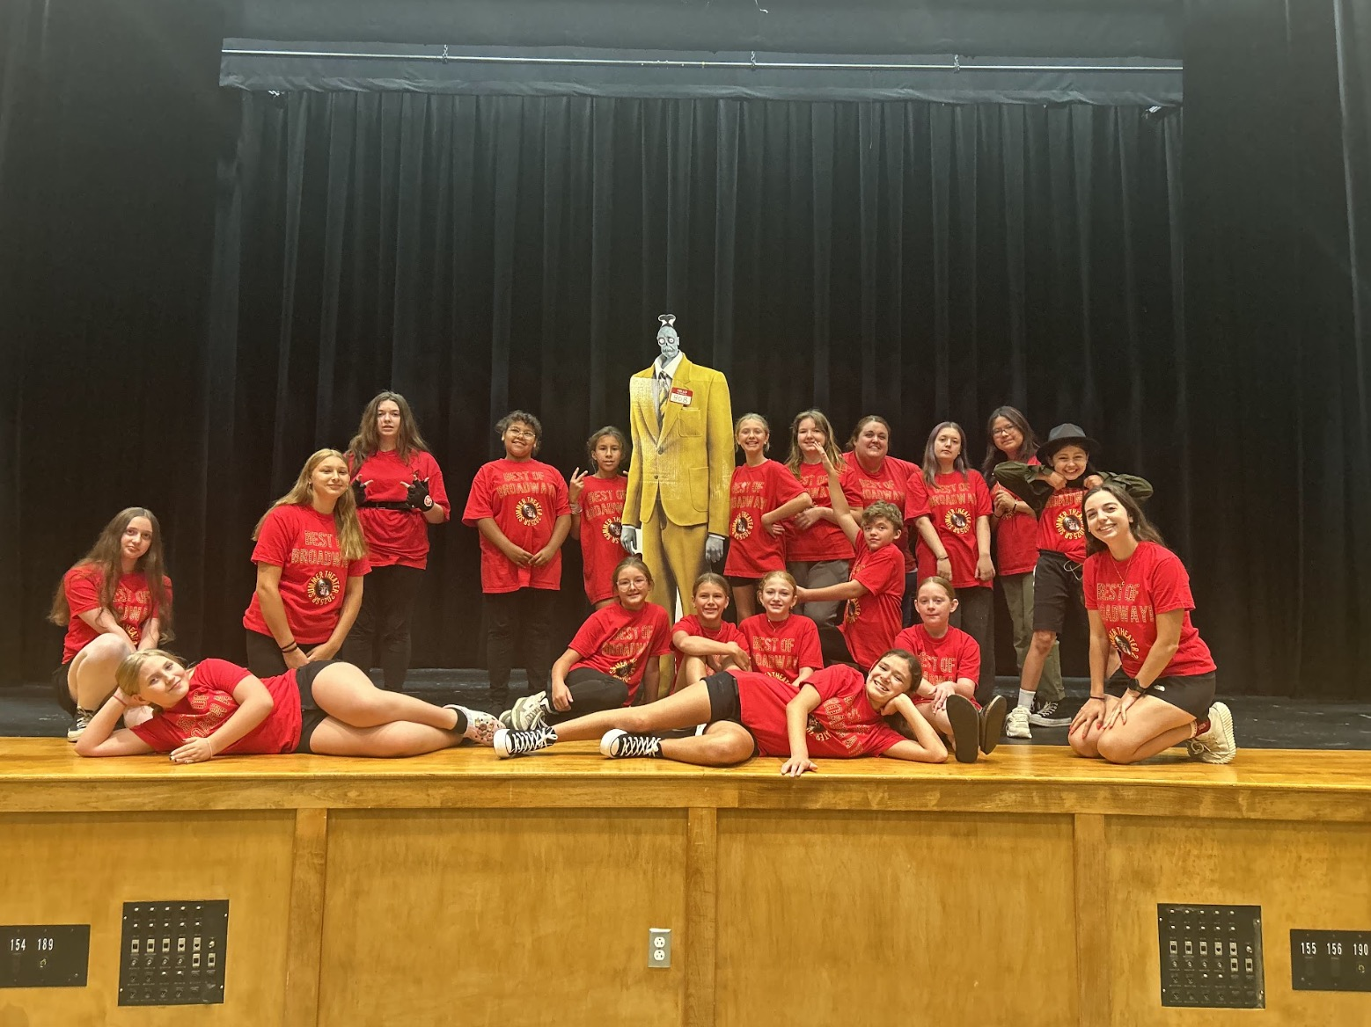
Budget Development Goals
Student centered decisions
Preserve programs and services where possible
Maintain safe, effective district operations
Balance fiscal responsibility with long-term stability

Slide 4
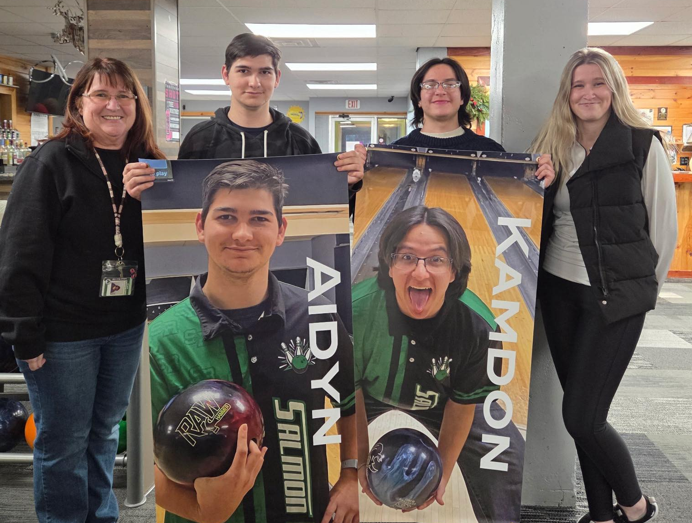
Budget Drivers
Health Insurance Costs
Contractual Salaries
Utilities and Fuel Costs
Special Education Costs
State Aid
Property Tax Limits

Slide 5
REVENUES
Foundation Aid Increase $815,779
Building Aid Decrease $861,713
Using more Fund Balance to balance the budget
State Aid = 88% of Revenues

Slide 6
EXPENSES
Salaries
4.25% Instructional
5-7% Noninstructional
Benefits
Health insurance 22%
Retirement costs stable
Debt Service
15 year bonds aligned with Building Aid over same period
BOCES
Expense based aid
Increasing due to health insurance costs

Slide 7
FRINGE BENEFITS
Health Insurance cost increase is 22% - $2M increase
Family Plan cost - $36,288
Approximately 86 employees do not take health insurance plans
Teachers Retirement System – Decrease from 9.59% to 8.24%
Employee Retirement System – Increase from 15.44% to 16.51%

Slide 8
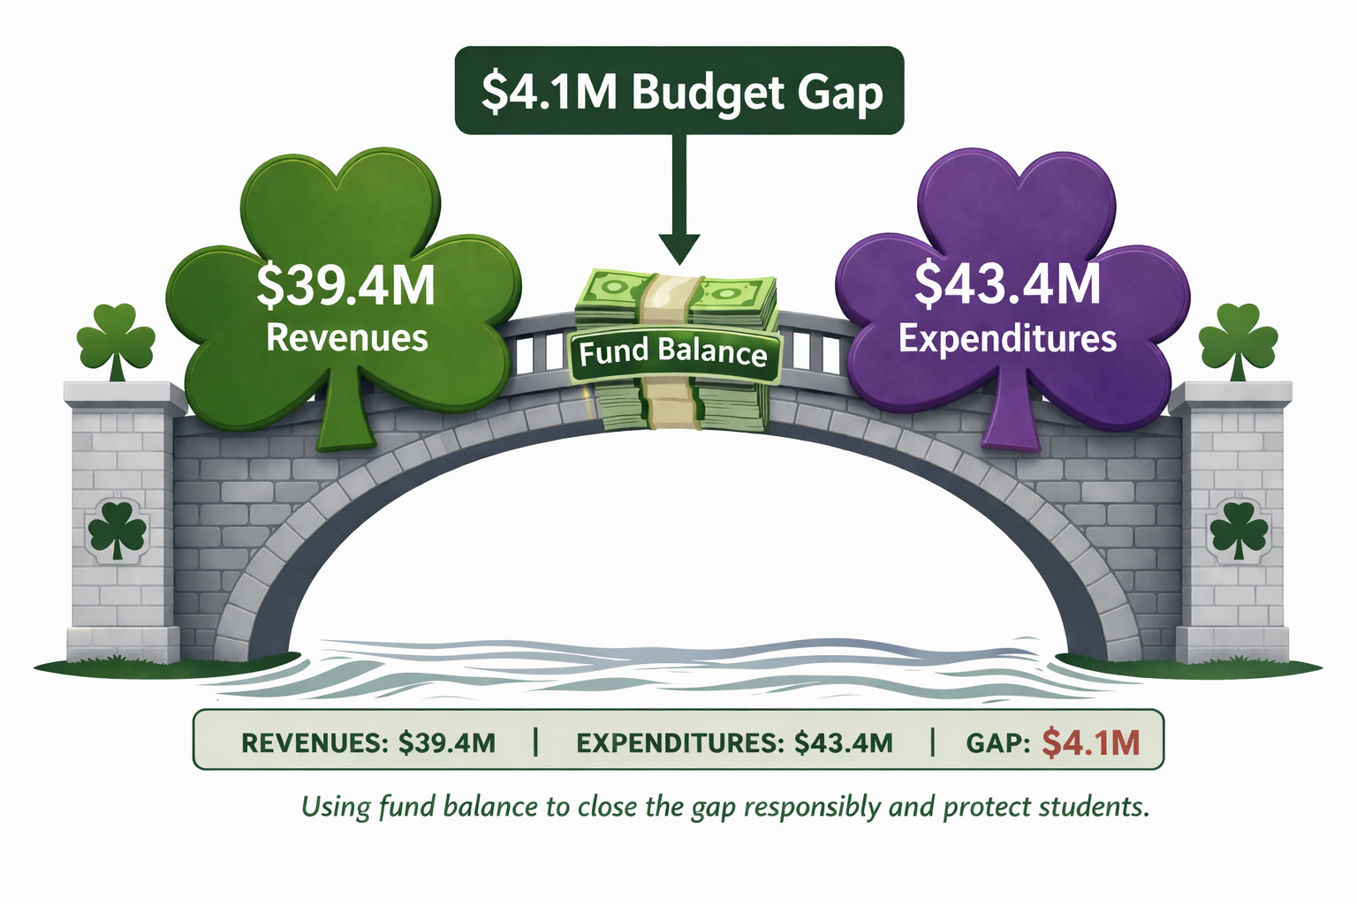
Where we started – budget gap

Slide 9
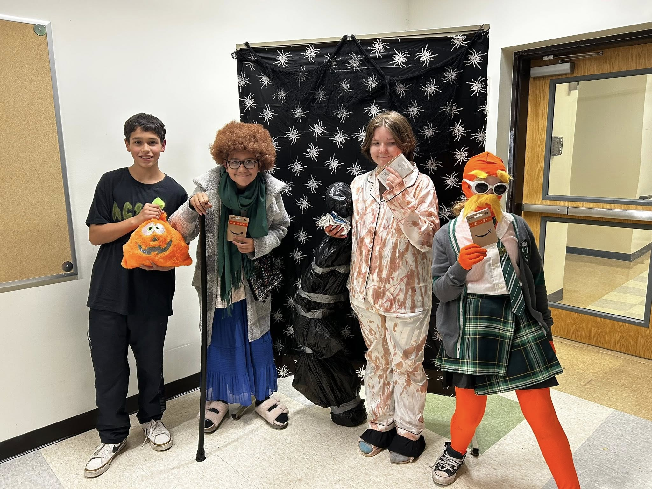
Closing the Budget Gap Through Careful, Strategic Decision-Making
Staff reductions through attrition and restructuring
Decreased supply and equipment budgets
Reduction in BOCES services
Budget revenues to more closely reflect actual
Use additional fund balance
Every budget decision was made with the goal of protecting students while maintaining fiscal responsibility
Notes:
The district closed the budget gap through a combination of strategic decisions. No single reduction solved the problem. Instead, we made thoughtful adjustments in staffing, spending, revenue assumptions, and service levels
Eliminated positions through attrition Lowered supply codes Lowered equipment budget Budgeted revenues closer Used more fund balance Eliminated select BOCES services

Slide 10

Budget Reductions
1 FTE Administrator
3 FTE Elementary Teacher
1 FTE Library Media Specialist
2 FTE Resource Room Teachers
1 FTE Math Teacher
1 FTE Math AIS/IST Teacher
1 FTE Student Support Service Professional
1 FTE Custodian
Sunset Program
Holistic Life Foundation
Through attrition the district reduced staffing costs in a more gradual and less disruptive way. This approach helped us manage the budget while minimizing the impact on people and programs.
Notes:
Managed vacancies through retirements and resignations Avoided layoffs whenever possible Limited disruption to staff and students Aligned staffing with district needs and budget realities

Slide 11

What This Budget Preserves
Maintains core academic programs and services
Special Education Programming
Academic Interventions
Summer School
Athletics
After School Programs
Addition of Full Time Agricultural Teacher

Slide 12
Year to Year Budget Comparison
REVENUES | 2025-2026 | 2026-2027 | Difference
PROPERTY TAX | $ 2,036,653 | $ 2,077,386 | $ 40,733
STATE AID | $29,576,650 | $29,648,260 | $ 71,610
NATIVE AMERICAN AID | $ 7,575,739 | $ 8,009,853 | $ 434,114
OTHER | $ 593,397 | $ 782,130 | $ 188,733
TOTAL | $39,782,439 | $40,517,629 | $ 735,190
EXPENDITURES | 2025-2026 | 2026-2027 | Difference
SALARIES & BENEFITS | $28,552,895 | $29,293,800 | $ 740,905
BOCES | $ 4,112,343 | $ 4,605,569 | $ 493,226
SUPPLIES & CONTRACTUAL | $ 3,927,955 | $ 3,922,450 | $ (5,505)
DEBT SERVICE | $ 4,851,781 | $ 4,794,207 | $ (57,574)
TOTAL | $41,444,974 | $42,616,026 | $1,171,052
FUND BALANCE | $ 1,662,535 | $ 2,098,397 | $ 435,862

Slide 13
Understanding Fund Balance Over Time
Reserved (Green)
Funds legally set aside for future purpose
Capital, retirement, employee benefits, insurance
Cannot be used for general operating expenses
Appropriated (Red)
Used to help balance budget in difficult years
Unappropriated (Orange)
remaining cushion for fiscal stability
Limited to 4% of next year’s budget
At the current rate of use, the District’s unappropriated fund balance is projected to be exhausted within the next two years, underscoring the need for long-term fiscal planning.

Slide 14
Property Tax Cap Calculation
The tax cap is often perceived as a fixed percentage, but in reality it is recalculated every year using variables outside district control.
Formula is driven by
CPI
PILOTS
Capital Exclusions
Tax base growth factors
The Tax Cap does not produce consistent or predictable rates
Historically, when budgets have allowed, the District has maintained less than 2% tax levy increases
1% increase in the tax levy = $20,366 in additional revenue
Year | Tax Cap
2017-2018 | 2%
2018-2019 | 0%
2019-2020 | 0%
2020-2021 | -4.5%
2021-2022 | -.99%
2022-2023 | 0%
2023-2024 | 0%
2024-2025 | 2%
2025-2026 | 2%
2026-2027 | 2%

Slide 15
PROPERTY TAXES
Tax levy has been steady over the last 10 years
Tax rate per $1,000 of assessed value has decreased significantly from $14.37 to $6.09
This is a result in the growth of the tax base not a decrease in the amount collected
Last year a $100,000 home resulted in a $378 tax bill with star exemptions

Slide 16
SCHOOL BUS REPLACEMENT PLAN
Five-Year Replacement Plan
Average age of buses is 6 years / 80,000 miles
Replace 4 buses annually
Annual budget impact after aid: $8,000
2026-2027 Replacement Plan
NYS Native American Transportation will no longer provide SED buses to the District moving forward
This will impact our replacement plan and financing
District will purchase additional buses to replace SED buses and be reimbursed on the Native American Transportation contract.
Replace 8 buses at a cost not to exceed $1,400,000
The bus purchase reflects a planned replacement of aging vehicles to maintain student safety, control rising maintenance costs, and ensure reliable transportation service.

Slide 17


NEXT STEPS
May 6, 2026
5pm – Budget Hearing
May 19, 2026
12-8pm – Budget Vote

